Slide 1
Simulation of Mammalian Sperm in Viscous Media
Sunil Klein
Yuan-Hung Lo

Slide 2
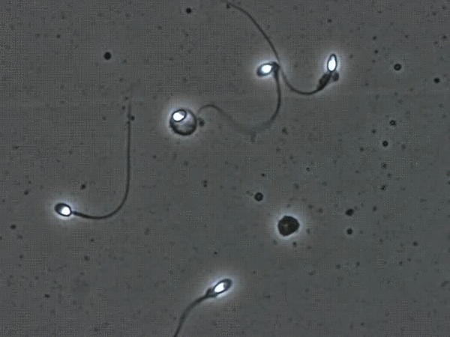
Overview of project
Goal:
MATLAB simulation of an actuated sperm-inspired robot in a viscous fluid
Simulate progressive motility and control movement direction
Methods:
Based on a discrete elastic beam
2D simulation to capture lateral, whip-like flagellum motion
Assumptions:
Low Reynolds number
Newtonian fluid
Image Source
Movement of Sperm
Notes:
S

Slide 3
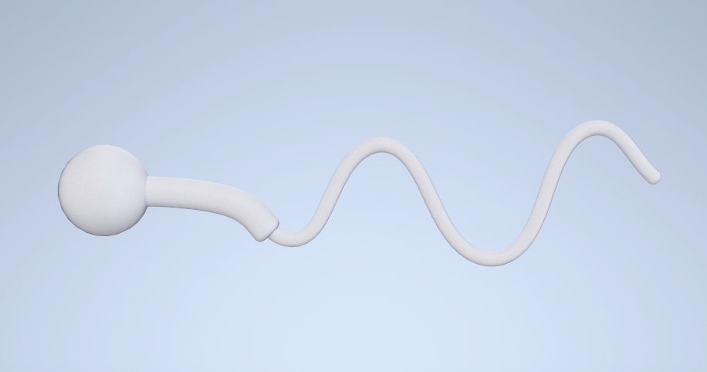
Geometry Modeling
Modeled the nodes in the DER system according to the shape of a sperm.
Included the geometry of midpiece and head to recreate sperm’s dynamic characteristic.
Scaled up to better show simulation result.
Simplified Sperm Model
Total length | 0.5 m
Head radius | 15 mm
Midpiece radius | 5 mm
Flagellum radius | 2.5 mm
Model Dimension
Notes:
Low Reynolds Number: for microorganisms like sperm, inertial effects are negligible compared to viscous effects; behaves more like a Newtonian fluid; easier to model

Slide 4
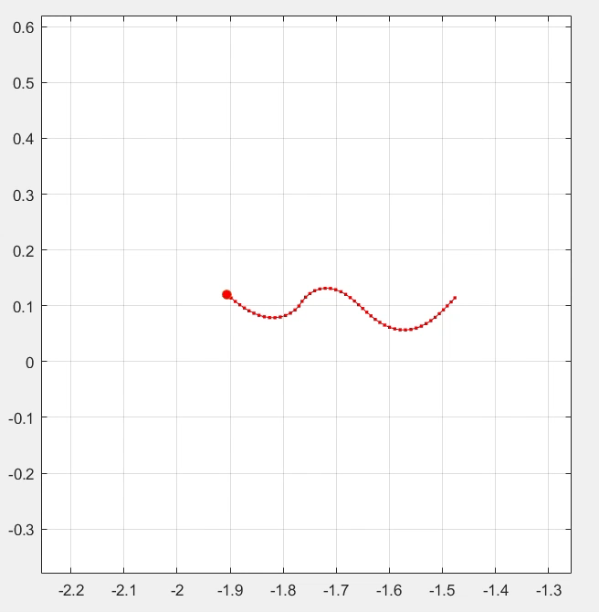
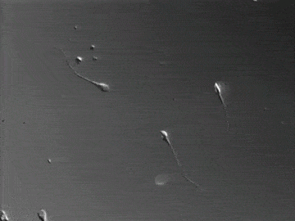
Actuation
Change the natural curvature in our equation, generate force with deformation.
Oscillating beating motion in the midpiece to resemble sperm movement.
Increase swimming efficiency and stability.
Self Propelled Sperm in Viscous Fluid
Image Source
Movement of Actual Sperm
Notes:
Low Reynolds Number: for microorganisms like sperm, inertial effects are negligible compared to viscous effects; behaves more like a Newtonian fluid; easier to model
At vertical position wrist position, base motor and wrist angle axes are aligned changing the angle wont change its position

Slide 5
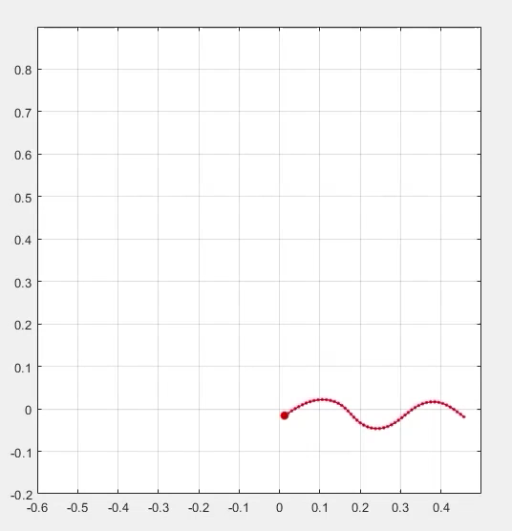
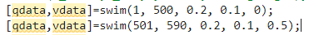
Path Control
Introduce phase shift in curvature to change swimming direction.
Capable of controlling the motion precisely and follow a certain path.
Made the code into a function to easily plan out series of movement.
Directional Controlled Sperm Following Designed Path
Notes:
Low Reynolds Number: for microorganisms like sperm, inertial effects are negligible compared to viscous effects; behaves more like a Newtonian fluid; easier to model
At vertical position wrist position, base motor and wrist angle axes are aligned changing the angle wont change its position

Slide 6
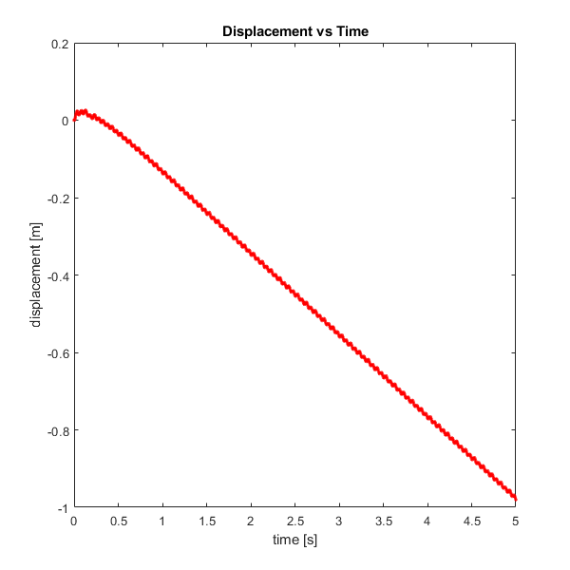
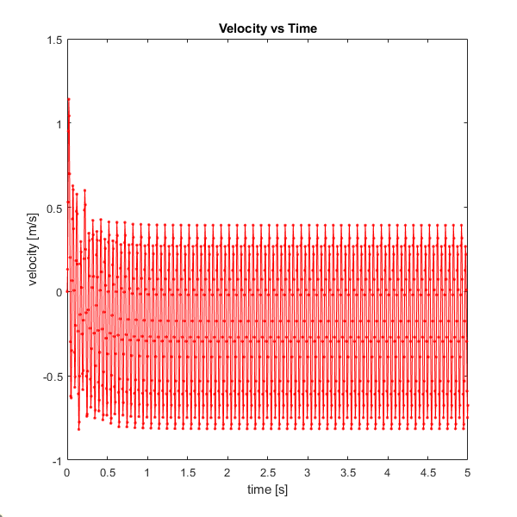
Mobility Analysis
Difference in beating magnitude and frequency can greatly affect motility.
Reaches terminal velocity of 0.21 m/s
≈ 0.42 body-length per second
Actual sperm moves at 0.1~2 bps.
Frequency | 10 Hz
Magnitude (curvature) | 0.2 radian
Displacement and velocity of sperm head over 15 seconds
Notes:
Low Reynolds Number: for microorganisms like sperm, inertial effects are negligible compared to viscous effects; behaves more like a Newtonian fluid; easier to model
At vertical position wrist position, base motor and wrist angle axes are aligned changing the angle wont change its position

Slide 7
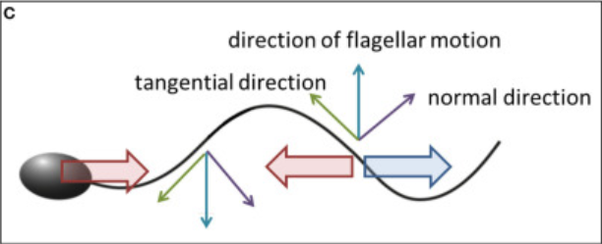
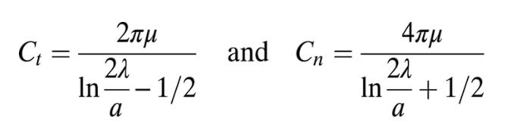
Gray and Hancock Drag Coefficients
Capture the influence of hydrodynamic forces on the sperm
Twice as much force required for sperm to move radially than tangentially
Updated Jacobian and force matrices; integrated drag forces for both tangential and normal contributions
Image Source
Gray and Hancock’s drag coefficients [9]
Notes:
S

Slide 8
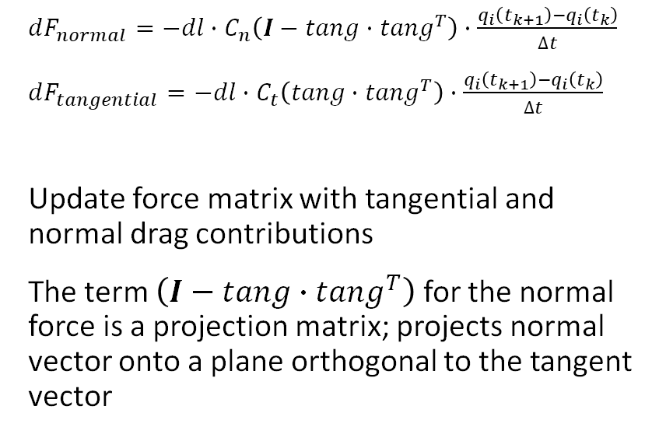
Implementation of Drag Forces
Computation of drag forces for more realistic system dynamics
Tailored node-specific calculations of drag forces for head, midpiece, and flagellum nodes
Sperm exerts force the fluid, propels it forward
$dF_{normal}=−dl∙C_{n}\left(I−tang∙{tang}^{T}\right)∙\frac{q_{i}\left(t_{k+1}\right)−q_{i}\left(t_{k}\right)}{∆t}$
$dF_{tangential}=−dl∙C_{t}\left(tang∙{tang}^{T}\right)∙\frac{q_{i}\left(t_{k+1}\right)−q_{i}\left(t_{k}\right)}{∆t}$
Update force matrix with tangential and normal drag contributions
The term $\left(I−tang∙{tang}^{T}\right)$ for the normal force is a projection matrix; projects normal vector onto a plane orthogonal to the tangent vector
Notes:
S

Slide 9
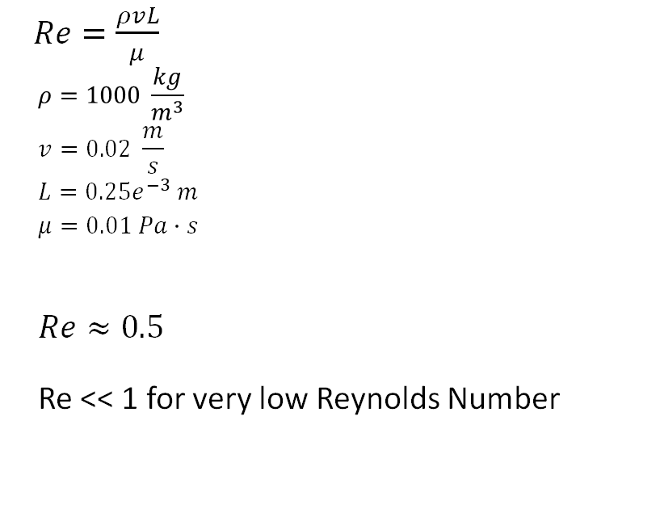
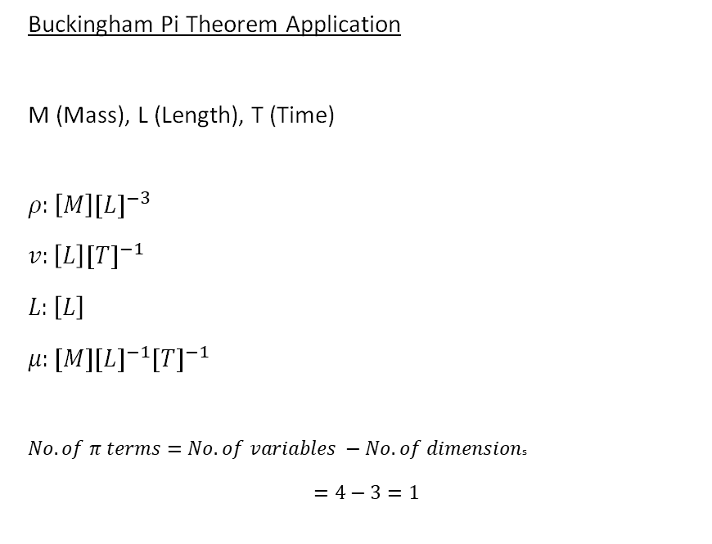
Reynolds Number Approximation
$Re=\frac{ρvL}{μ}$
$$ρ=1000 \frac{kg}{m^{3}}$$
$$v=0.02 \frac{m}{s}$$
$$L={0.25e}^{−3} m$$
$$μ=0.01 Pa∙s$$
$$Re≈0.5$$
Re << 1 for very low Reynolds Number
Buckingham Pi Theorem Application
M (Mass), L (Length), T (Time)
$ρ:\left[M\right]{[L]}^{−3}$
$v:\left[L\right]{[T]}^{−1}$
$L:\left[L\right]$
$μ:[M]{[L]}^{−1}{[T]}^{−1}$
$No. of π terms=No. of variables −No. of dimension$s
$=4−3=1$
Notes:
S

Slide 10
Future Work
Test simulation under micro scale environment.
Implement dimensionless quantities to help ensure very low Reynolds number.
Explore the effect of flagellum buckling on changing direction.
Notes:
S

Slide 11
References
[1] Cass, James F., and Hermes Bloomfield-Gadêlha. “The Reaction-Diffusion Basis of Animated Patterns in Eukaryotic Flagella.” Nature News, Nature Publishing Group, 27 Sept. 2023, www.nature.com/articles/s41467-023-40338-2.
[2] Corkidi, G., et al. “Long-Term Segmentation-Free Assessment of Head-Flagellum Movement and Intracellular Calcium in Swimming Human Sperm.” University of Bristol, Company of Biologists Ltd, 11 Feb. 2022, research-information.bris.ac.uk/en/publications/long-term-segmentation-free-assessment-of-head-flagellum-movement.
[3] Forghani, Mojtaba, et al. “Control of Uniflagellar Soft Robots at Low Reynolds Number Using Buckling Instability.” ASME Digital Collection, American Society of Mechanical Engineers Digital Collection, 1 Feb. 2021, asmedigitalcollection.asme.org/dynamicsystems/article/143/6/061004/1094088/Control-of-Uniflagellar-Soft-Robots-at-Low.
[4] Gadelha, H, et al. Nonlinear Instability in Flagellar Dynamics: A Novel Modulation Mechanism in Sperm Migration?, Royal Society Publishing, 12 May 2010, royalsocietypublishing.org/doi/10.1098/rsif.2010.0136.
[5] Gadelha, Hermes, and Eamonn Gaffney. Flagellar Ultrastructure Suppresses Buckling Instabilities and Enables Mammalian Sperm Navigation in High-Viscosity Media, Royal Society Publishing, 20 Mar. 2019, royalsocietypublishing.org/doi/10.1098/rsif.2018.0668.
[6] Huang, Weicheng, and M. K. Jawed. “Numerical Exploration on Buckling Instability for Directional Control in Flagellar Propulsion.” Soft Matter, The Royal Society of Chemistry, 10 Dec. 2019, pubs.rsc.org/en/content/articlelanding/2020/SM/C9SM01843C.
[7] Leung, Miguel Ricardo, et al. The Multi-Scale Architecture of Mammalian Sperm Flagella and Implications for Ciliary Motility, Embo Press, 10 Mar. 2021, www.embopress.org/doi/full/10.15252/embj.2020107410.
[8] Moreau, Clement, et al. The Asymptotic Coarse-Graining Formulation of Slender-Rods, Bio-Filaments and Flagella, Royal Society Publishing, 4 July 2018, royalsocietypublishing.org/doi/10.1098/rsif.2018.0235.
[9] Rodenborn, Bruce, et al. “Propulsion of Microorganisms by a Helical Flagellum | PNAS.” Propulsion of Microorganisms by a Helical Flagellum, PNAS, 28 Nov. 2012, www.pnas.org/doi/10.1073/pnas.1219831110.
[10] Simons, Julie E., and Sarah D. Olson. “Sperm Motility: Models for Dynamic Behavior in Complex Environments.” SpringerLink, Springer International Publishing, 1 Jan. 1970, link.springer.com/chapter/10.1007/978-3-319-96842-1_7.
[11] Smith, D.J., et al. Bend Propagation in the Flagella of Migrating Human Sperm, and Its Modulation by Viscosity, Wiley Online Library, 25 Feb. 2009, onlinelibrary.wiley.com/doi/abs/10.1002/cm.20345.

Slide 12
Questions

